Slide 1

Innovative Institutions

Slide 2
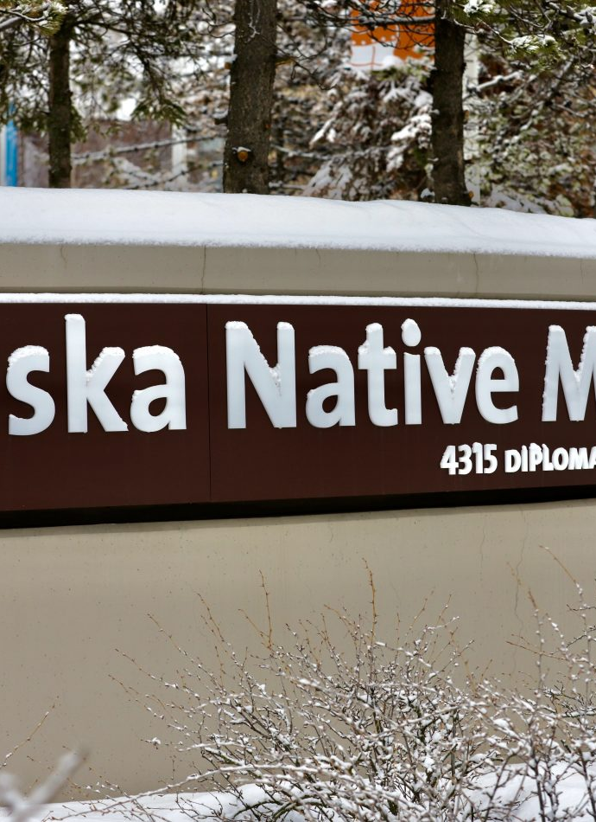
Example 1 HEALTHCARE
Alaska Native Medical Centre – run by the largest tribal health organization in the country
Recognizing that many of their Indigenous (Aluet, Tlingit, etc.) patients were far from home, the centre and its main chef decided to offer a food menu that was reflective of their patients’ home culture and their comfort food
Created Traditional Native Food Initiative that allows people to donate wild game, seal, fish, etc.
Similar programs exist in Canada in Sioux Lookout and Yukon
https://www.cbc.ca/radio/unreserved/meet-the-chef-who-learned-to-cook-with-seal-and-other-indigenous-foods-at-alaska-hospital-1.6330188 (30 min. mark)

Slide 3
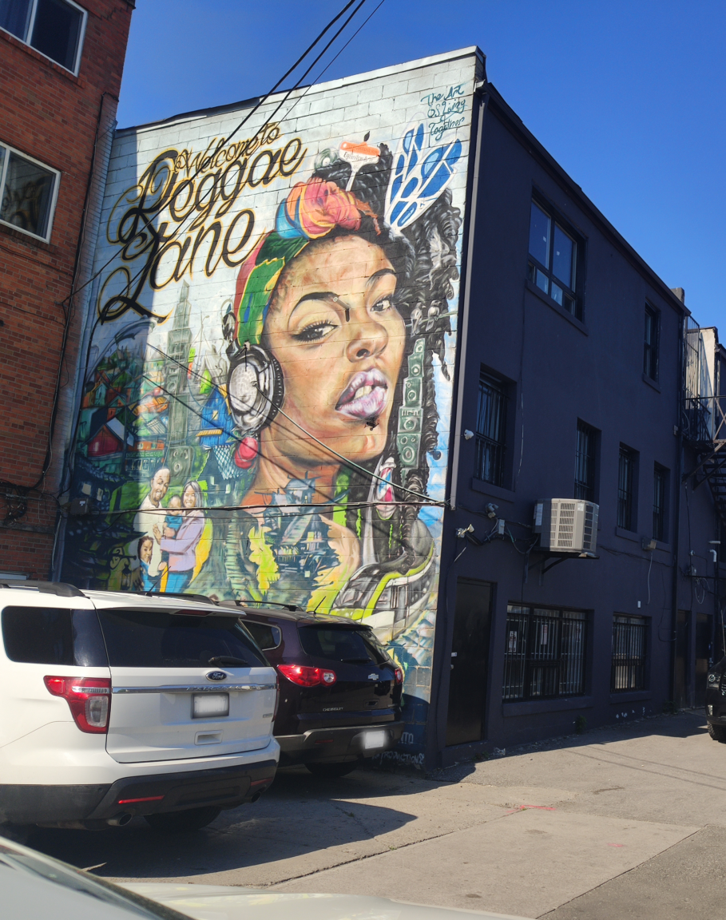
Example 2 URBAN PLANNING
In Toronto, the Black community is intervening in urban planning
Black Planning Now, Black Futures, Black urbanismTO are all speaking out about gentrification and forced resettlement of Black community members
BUTO, for instance, is working to help Black businesses own property in Toronto’s Little Jamaica neighbourhood
Futurepreneur: https://toronto.citynews.ca/video/2022/02/03/black-entrepreneur-startup-program/

Slide 4
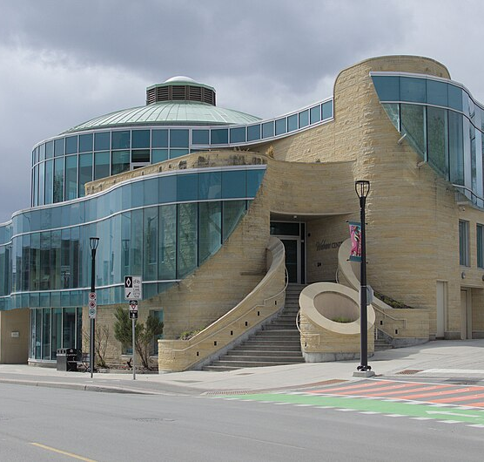
Example 3 HEALTHCARE
Wabano Centre: https://www.youtube.com/watch?v=nhlpPkDM204

Slide 5
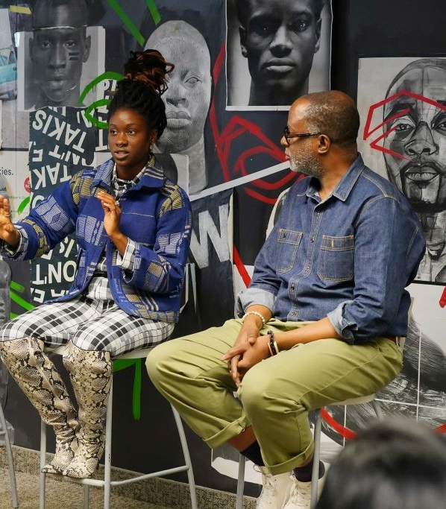
Example 4 ARTS
Nia Centre for the Arts is a Toronto-based not-for-profit organization that supports, showcases, and promotes arts from across the African diaspora
https://vimeo.com/469858119 (12min mark)

Slide 6
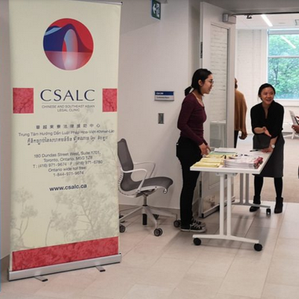
Example 5 LAW
The Chinese and Southeast Asian Legal Clinic (CSALC) is a community based legal clinic funded by Legal Aid Ontario which provides free legal services to low income, non-English speaking clients from the Chinese, Vietnamese, Laotian and Cambodian communities in Ontario. …
In addition to providing direct legal services, we empower the communities we serve through public legal education.
Advocating for law reform is another priority of our Clinic. Our Clinic has been involved in test case litigation, organizing grassroots campaigns, and making numerous submissions to all levels of government and to international human rights bodies to advance the rights of our clients and the broader communities of disadvantaged groups.
https://www.youtube.com/watch?v=7_v3cSXXzmw

Slide 7
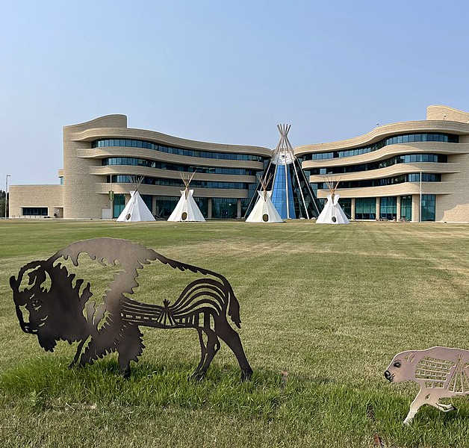
Example 6 EDUCATION
First Nations University of Canada seeks to have an ongoing transformative impact through education based on a foundation of Indigenous Knowledge. The Regina campus is situated on the atim kâ-mihkosit (Red Dog) Urban Reserve, Star Blanket Cree Nation and Treaty 4 Territory. Star Blanket is the first First Nation in Canada to create an urban reserve specifically dedicated to the advancement of education.
https://www.fnuniv.ca/wp-content/uploads/FNUniv_Self_Guided_Tour.pdf

Slide 8
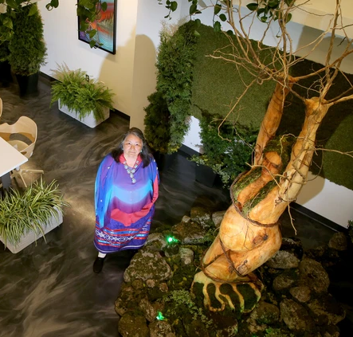
Example 7 COMMUNITY / NON-PROFIT
Native Women’s Association of Canada in Hull is a National Organization representing and supporting the voice of Indigeous women, girls, gender-diverse individuals, inclusive of First Nations, Metis, and Inuit, status and non-status.
The various programs, political endeavours, and research efforts of the association can all be found at: https://nwac.ca/about-us
Also, the centre where it is housed is worth a visit as it enacts the decolonizing mission of the association through its art gallery, live plant walls, and open atrium. https://youtu.be/Znf-sKQyeB4

Slide 9
Image credits
The Alaska Native Medical Center in Anchorage by Joey Mendolia/Alaska Public Media
Adrian Hayle’s mural by Farah Aldaghestani
Wabano Centre – Ottawa by Naevius Varius
Nia Centre for the Arts by Nia Centre for the Arts
Chinese and Southeast Asian Legal Clinic by Chinese and Southeast Asian Legal Clinic
Exterior Façade of the University’s Regina Campus by Daryl Mitchell
Indigenous elder Alma Brooks, from Wolastoq territory in New Brunswick, stands beside a sculpture made from a single piece of wood that anchors the new vast meeting room on the main floor of the new Social, Cultural and Economic Innovation Centre of the Native Women's Association of Canada in Gatineau by Julie Oliver /Postmedia

